Slide 1



Data Scientist Case #5
Christophe HAIKAL

Slide 2
TABLE OF CONTENTS
01
02
03
Data Analysis/ Visualisation
Prediction Model
Using the model output

Slide 3
Data Analysis/ Visualisation
1.1
1.2
Feature Engineering
Visualisations
Folium heatmap, Histogram (balance),Correlations and feature importance
Extracting features from dates, latitudes longitudes, create the target: Success

Slide 4

Features extraction: Date
year
month
day
dayofyear
dayofweek
weekday
weekday_name
quarter
hour
minutes

Slide 5
Create the target: Success
If 'confirmed_seat_count' > 0 then Success = True
Once this feature is created,
we drop :'confirmed_seat_count','seat_left_count'

Slide 6
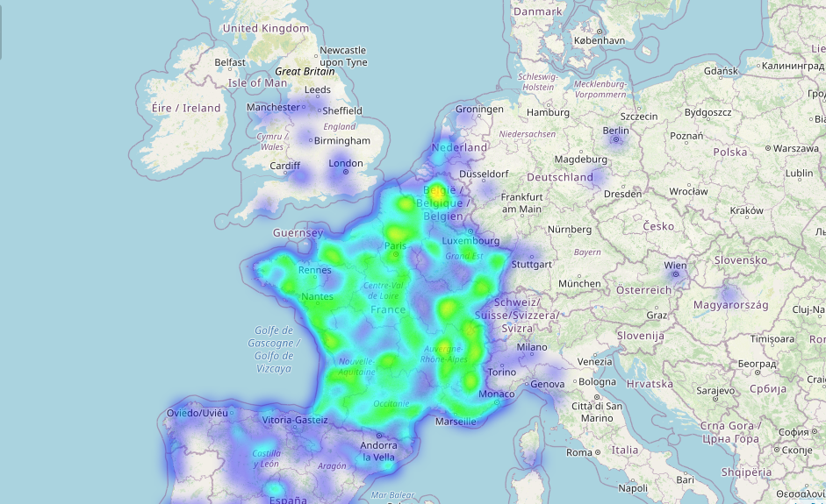
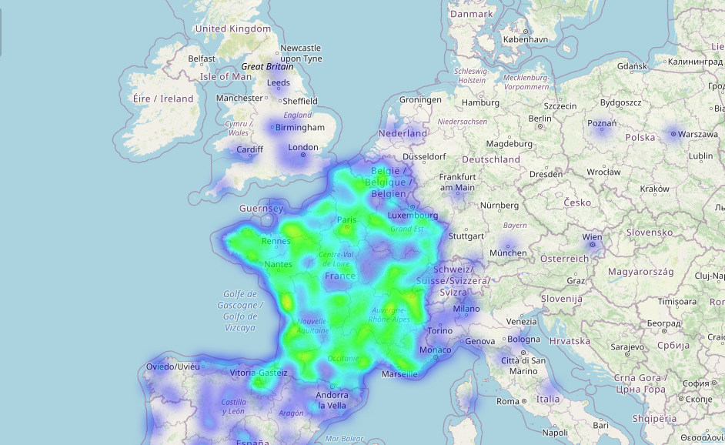
‘From’ Vs. ‘To’ Map

Slide 7
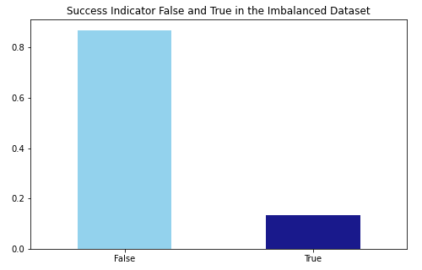
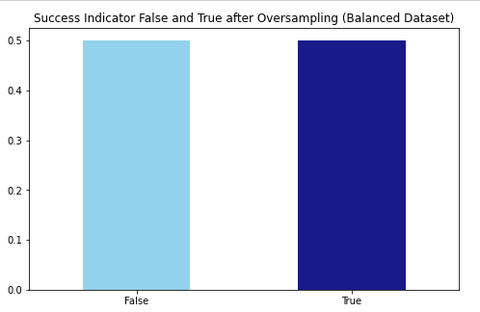
Balance

Slide 8
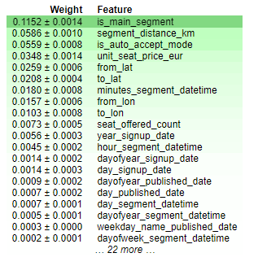
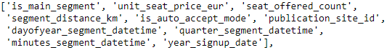
Feature Importance

Slide 9
Model Prediction
2.1
2.2
3.3
Training
Comparing
Bonus
Logistic Regression, Decision Tree, Random Forest, XGboost, LightGBM, Neural Network
Accuracy, ROC Area under Curve, Cohen's Kappa, Time taken for prediction,Time taken for fit and predict
From latitude and longitude to Geohash

Slide 10
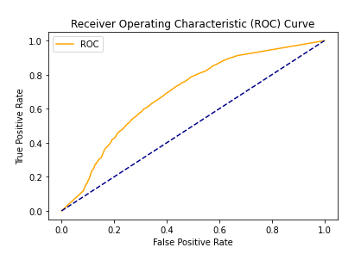
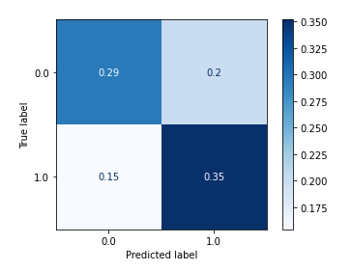
Training, Baseline: Decision Tree Classifier

Slide 11
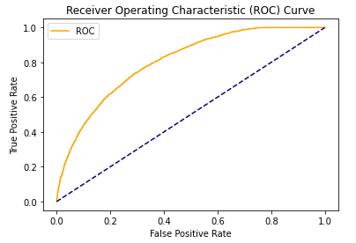
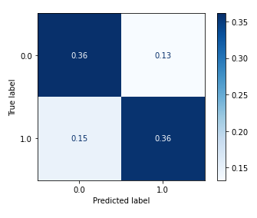
Training, Best model: Light GBM

Slide 12
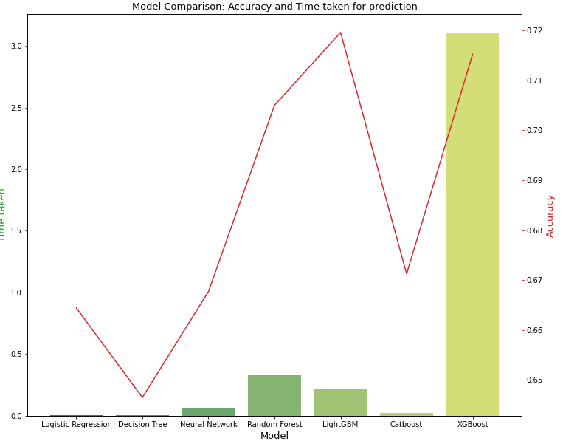
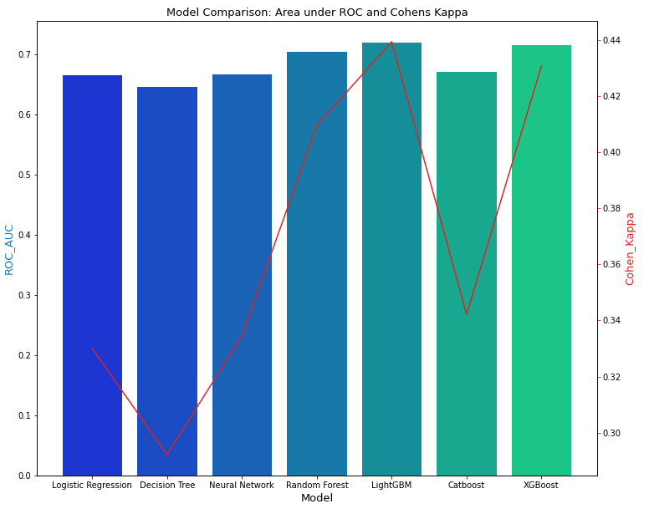
Comparing

Slide 13
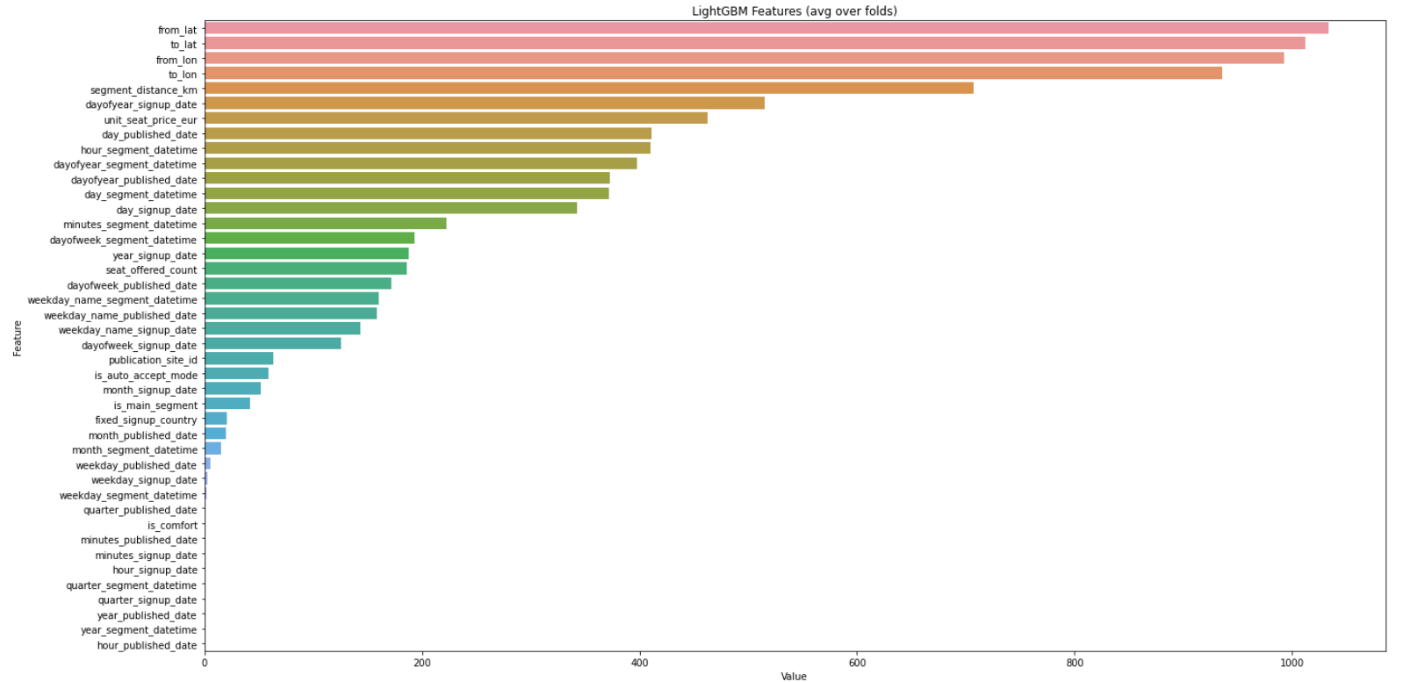
Feature Importance with the best Model

Slide 14
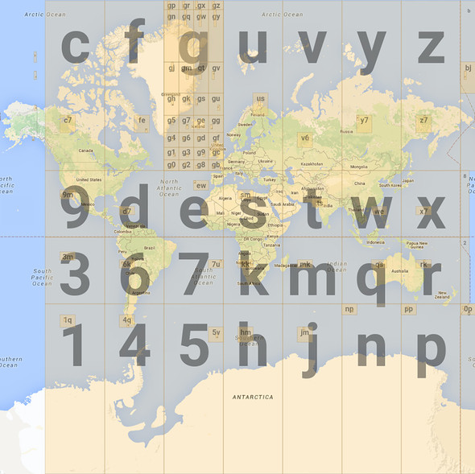
Bonus: Introducing Geohash

Slide 15
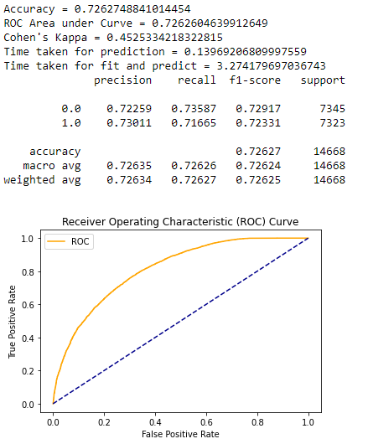
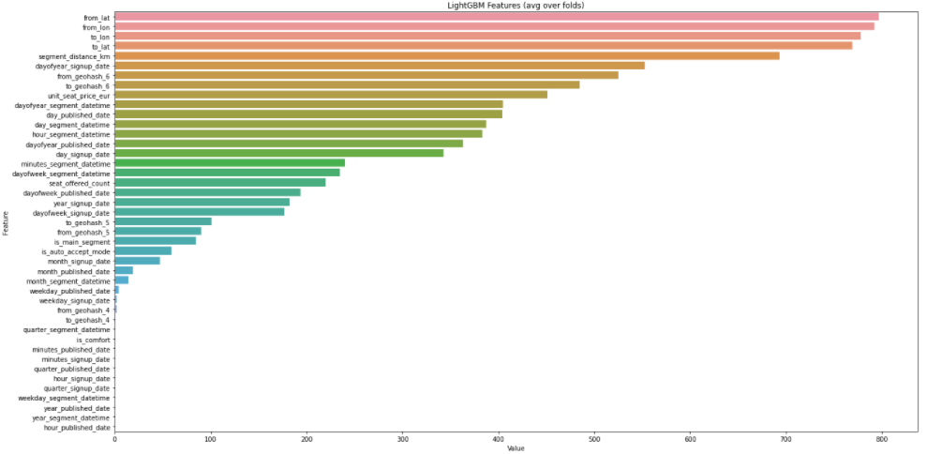
Bonus: Introducing Geohash from 0.719 to 0.726

Slide 16
Using the model output
3.1
3.2
3.3
Ranking algorithm
User recommandation
Business
decision support for users

Slide 17
Thank you

